Slide 1
16.216
ECE Application Programming
Instructor: Dr. Michael Geiger
Fall 2013
Lecture 26:
Exam 2 Review

Slide 2
Lecture outline
Announcements/reminders
  Program 7 due 11/13
  No class Monday, 11/11
Today’s class: Exam 2 Review
  Exam stats
  Regrade requests: due, in writing, 11/15
  Figuring out where you stand
  Exam solution
ECE Application Programming: Exam 2 Review

Slide 3
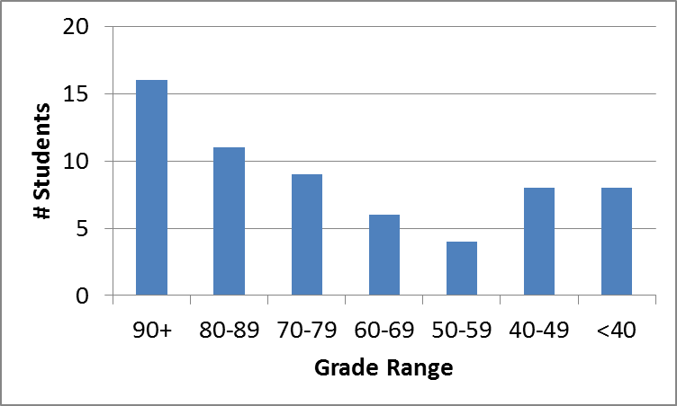
Exam stats & grade distribution
Average: 69.6
Median: 73
Std. deviation: 22
Max: 99
Question-by-question averages:
  Q1: 17.1 / 20 (85%)
  Q2: 29.3 / 40 (73%)
  Q3: 23.2 / 40 (58%)
Extra credit
  29 students completed
  4.6 average
ECE Application Programming: Exam 2 Review

Slide 4
Figuring out where you stand
Programs: 60% (6/10 done; 3/10 graded)
Exams: 40% (10% + 15% + 15%)
~60% of your grade still to be determined
  Note: That 60% includes not-yet-graded assignments for which you’ll have a chance to submit regrades
Estimating your grade
  Program avg (PA) = (total program points) / 2.5
  Exam avg (EA) =
  ((Exam 1) + (Exam 2 * 1.5)) / 2.5
  Overall avg = PA * 0.6 + EA * 0.4
ECE Application Programming: Exam 2 Review

Slide 5
Figuring out where you stand
Estimated avg = PA * 0.6 + EA * 0.4
Current course avg (will change):
  Without extra credit: ~82%, SD = 15
  With extra credit: ~83%, SD = 16
Likely avg down, SD up once grades/regrades done
May be curve, but do not assume there will be
Typical grading scale without curve
  A: 93+
  A-: 90-92
  B+: 88-89
  B: 83-87
  B-: 80-82
  C+: 78-79
  C: 73-77
  C-: 70-72
  D+: 68-69
  D: 60-67
  F: < 60
ECE Application Programming: Exam 2 Review

Slide 6
Next time
PE4: File I/O
Reminders:
  Program 7 due 11/13
  No class Monday, 11/11
ECE Application Programming: Exam 2 Review

